Slide 1


SWP391: FINAL PROJECT PRESENTATION
PROJECT BOOKSHOP ONLINE
GROUP3
NGUYEN XUAN NUI LECTURE

Slide 2
TABLE OF CONTENT
1.INTRODUCTION and Scope Project
2.PROJECT MANAGEMENT
3.USE CASE DIAGRAMS
4.SCREEN FLOW
5.MAIN SCREEN UI DESIGN
6.DATABASE DESIGN
7.PACKAGE DIAGRAM
8.CLASS DIAGRAM
9.SEQUENCE DIAGRAM
10.SHOPPING ONLINE workflows

Slide 3





TEAM MEMBER
BÙI QUỐC TRƯỞNG
HE160611
ĐỖ THẾ TÙNG
HE161150
TRẦN QUANG DIỆU
HE163095
ĐỖ TÙNG LÂM
HE163085
(LEADER)
HOÀNG TUẤN KIỆT
HE161307

Slide 4
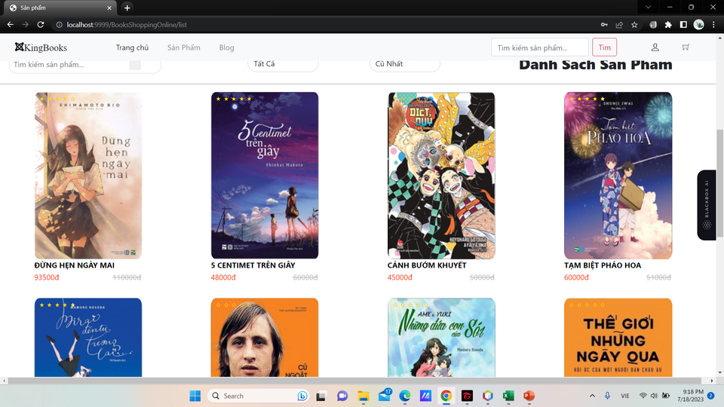

INTRODUCTION AND SCOPE
PROJECT
Welcome to Kingbooks website! We are proud to introduce you to a reliable, user-friendly, and extensive platform for online book shopping. To ensure quality and credibility, we provide a review and rating system for each book from readers who have purchased before. This helps you gain an overall perspective of the content and quality of each work before making a decision to buy.
Kingbooks is an online bookstore platform designed for people of all ages and interests. We offer a diverse collection with thousands of books covering various fields, from academia and entertainment to personal development.

Slide 5






Project Management
Project workspace
Gitlab
Netbean
MySQL
Docx
Meet

Slide 6
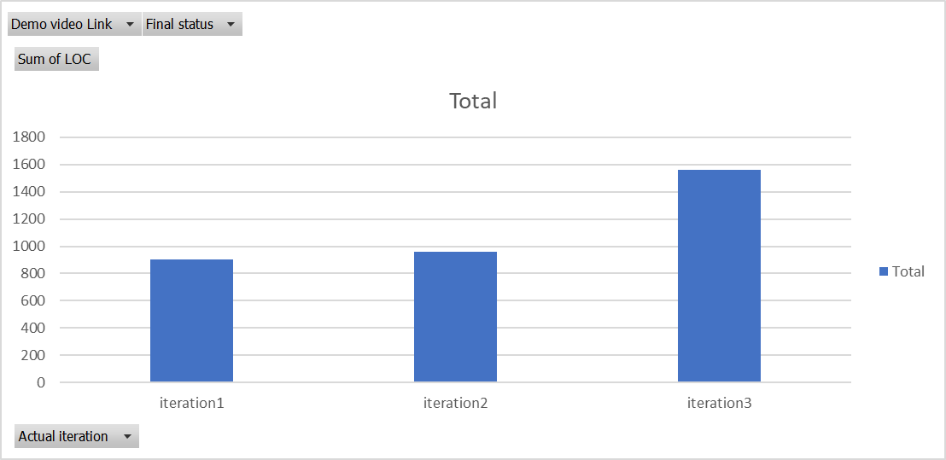
Project Management
Project process
Start Project : 8/05/2023
Done Project : 20/7/2023

Slide 7
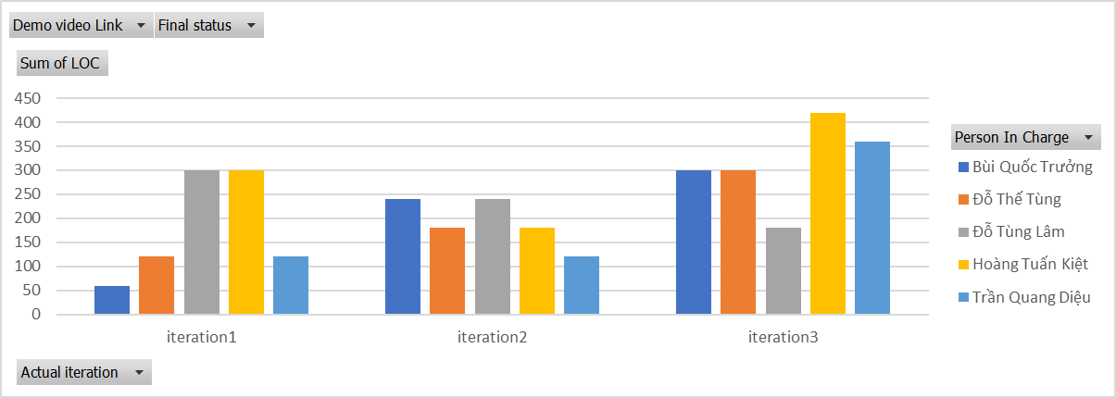
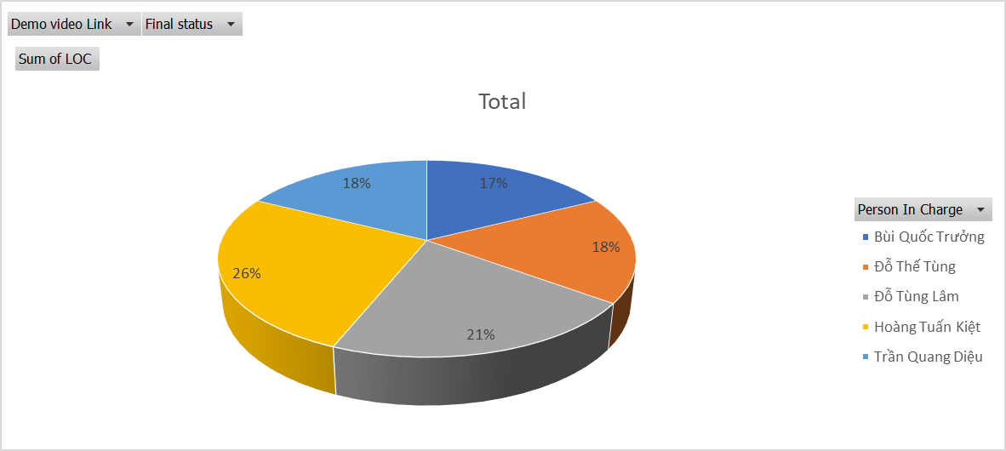
Project Management
Project Performance

Slide 8

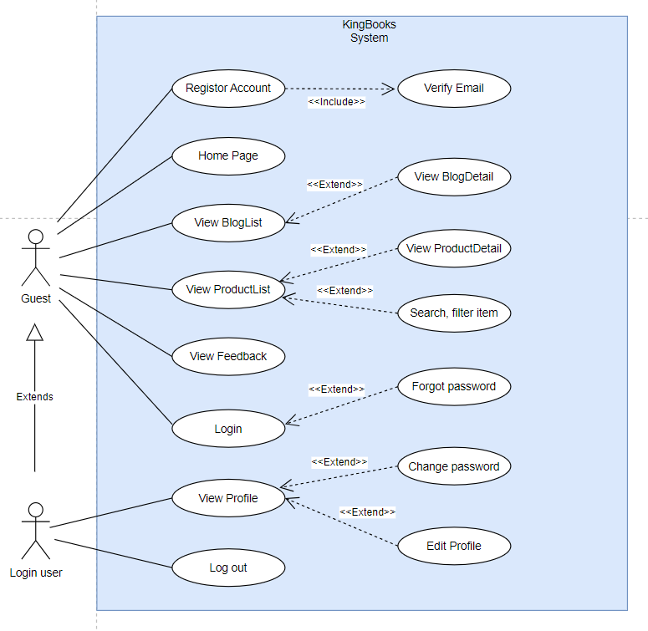
Use Case Diagrams (Login user - Guest)

Slide 9
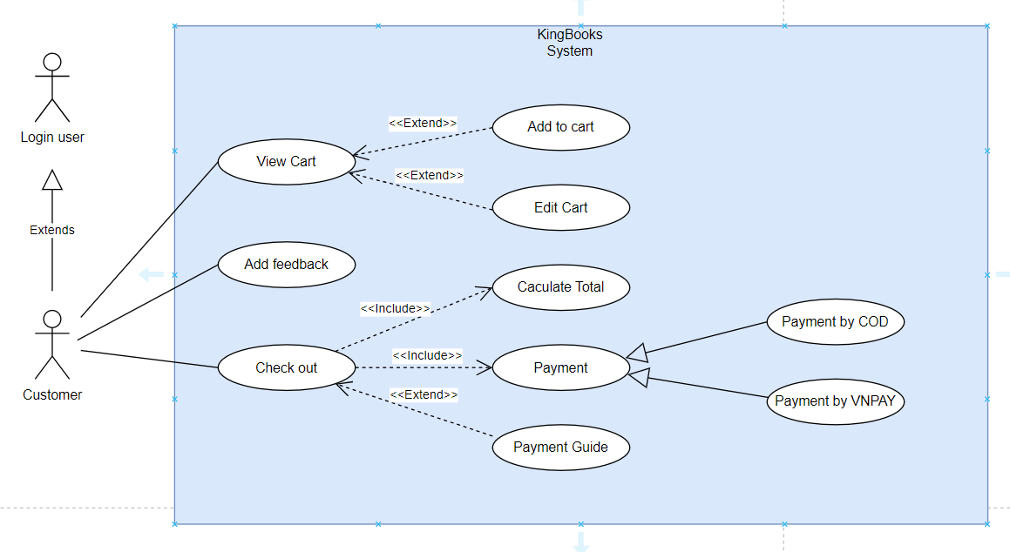
Use Case Diagrams (Customer)

Slide 10
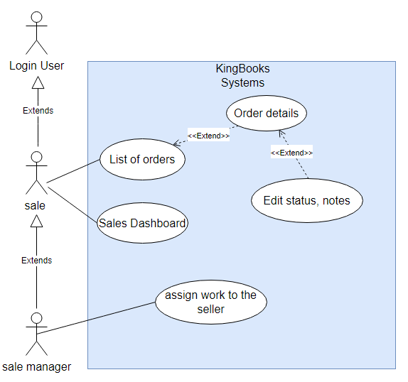
Use Case Diagrams (Sale-Sale Manager)

Slide 11

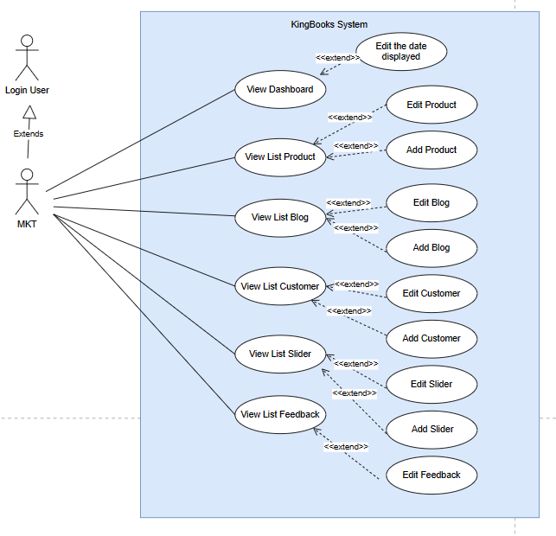
Use Case Diagrams
(Marketing)

Slide 12
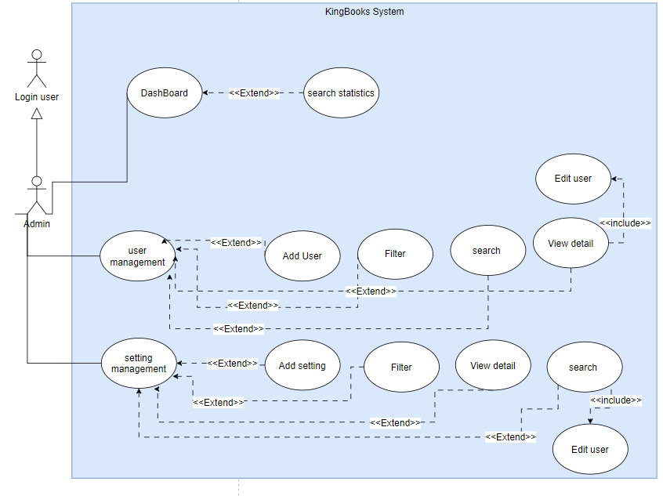
Use Case Diagrams
(Admin)

Slide 13
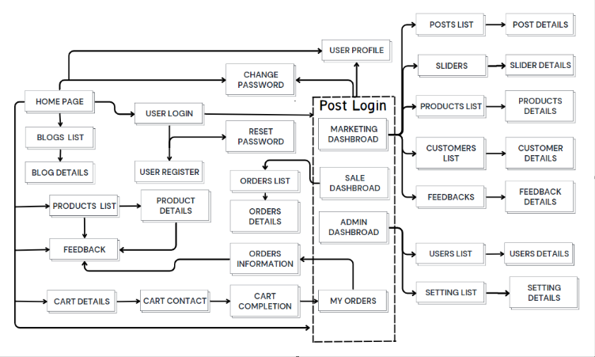
SCREEN FLOW

Slide 14


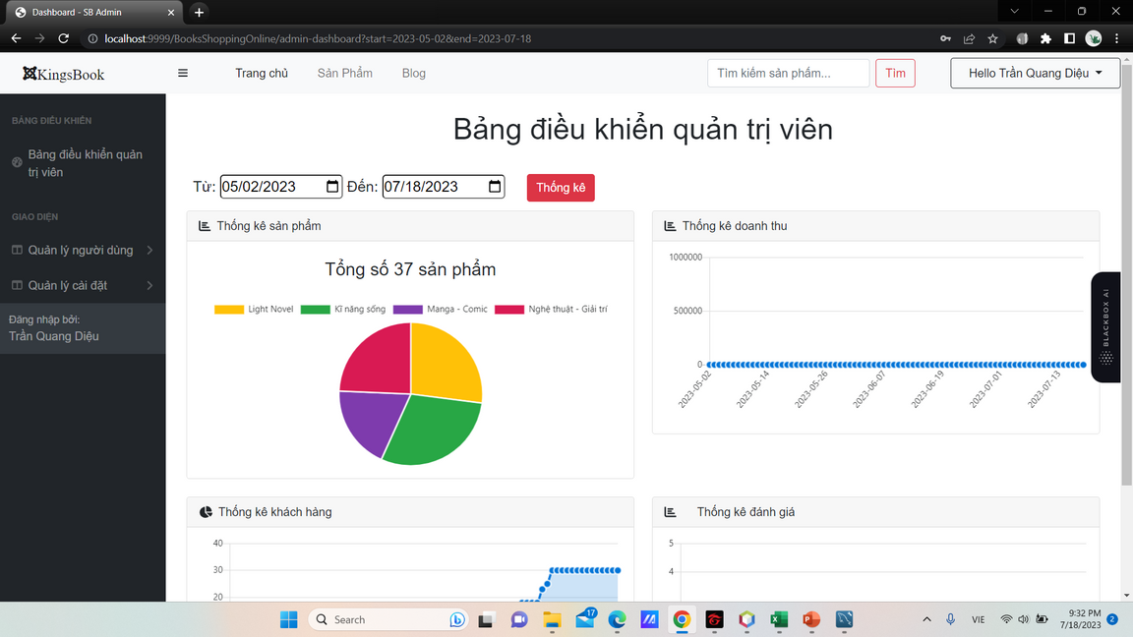
MAIN SCREEN UI DESIGN
MAIN WEB SCREEN: HOME PAGE
MAIN ADMIN SCREEN: DASHBOARD

Slide 15
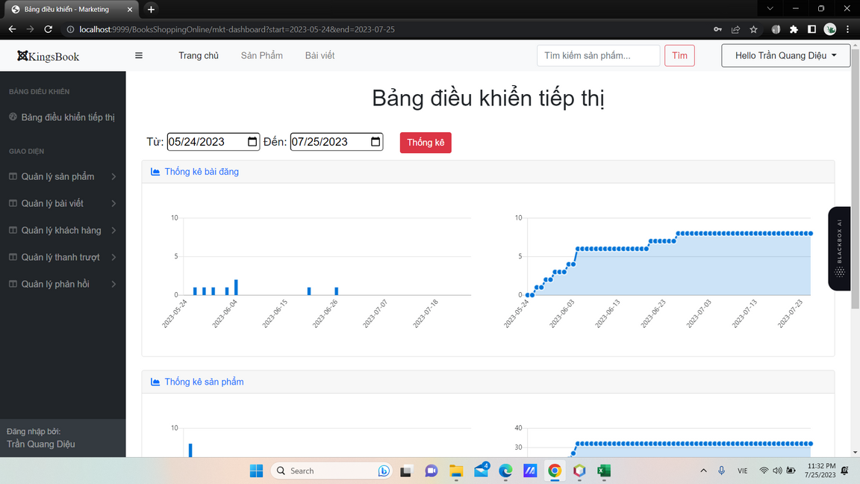
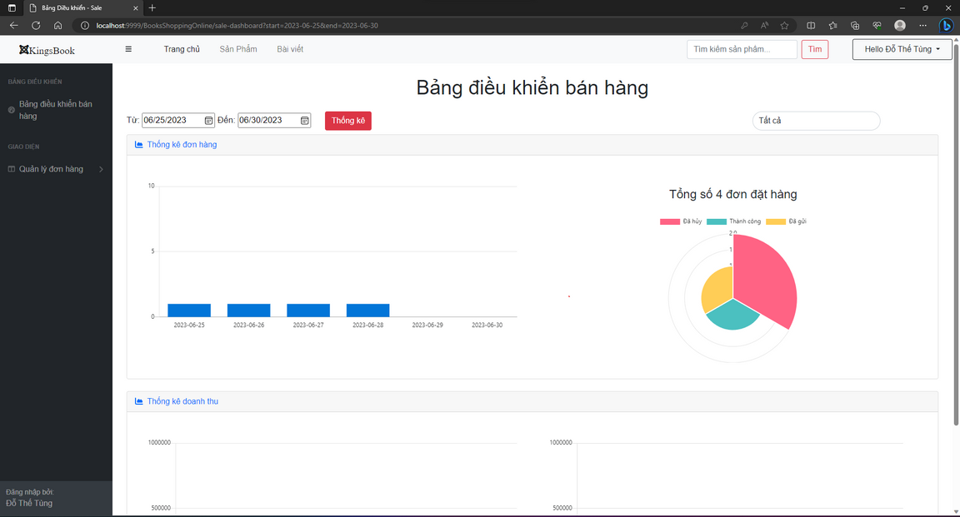
MAIN SCREEN UI DESIGN
MAIN MARKETING SCREEN:
DASHBOARD
MAIN SALER SCREEN:
DASHBOARD

Slide 16

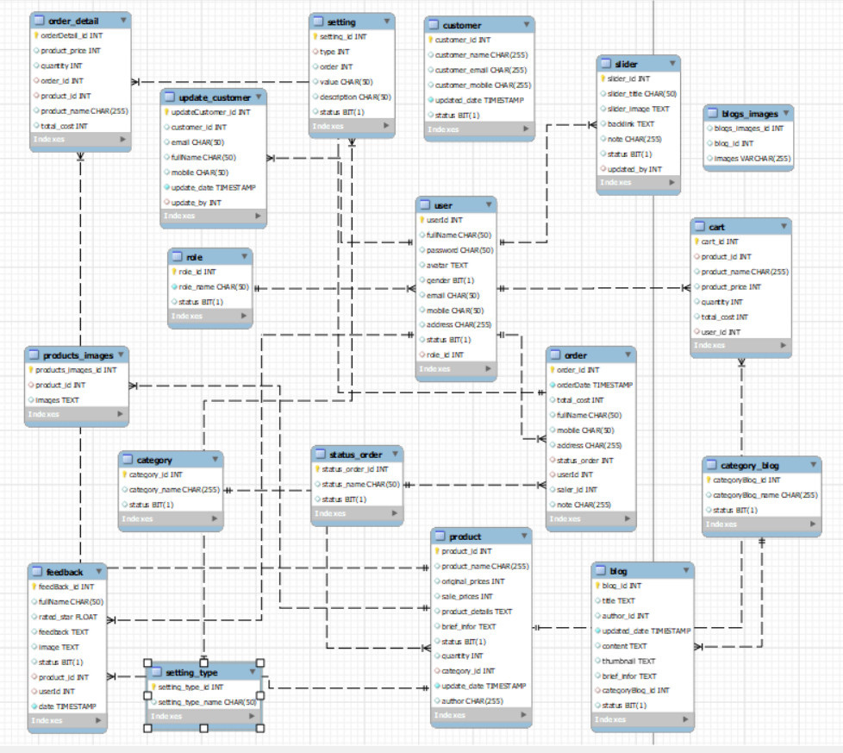
DATABASE DESIGN

Slide 17
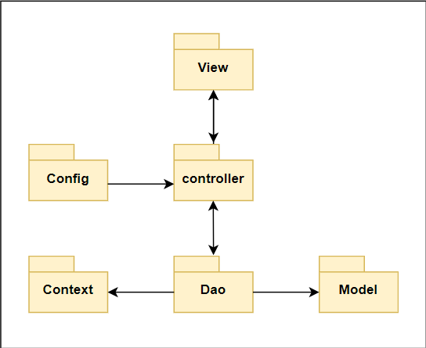
PACKAGE DIAGRAM

Slide 18
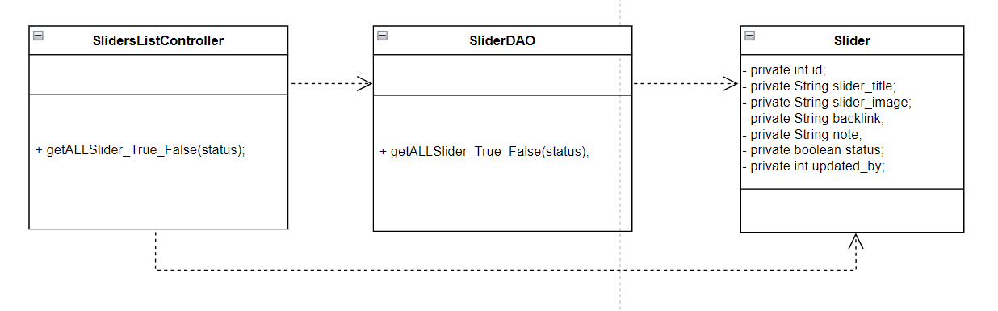
CLASS DIAGRAM (MKT SLIDERS LIST)

Slide 19
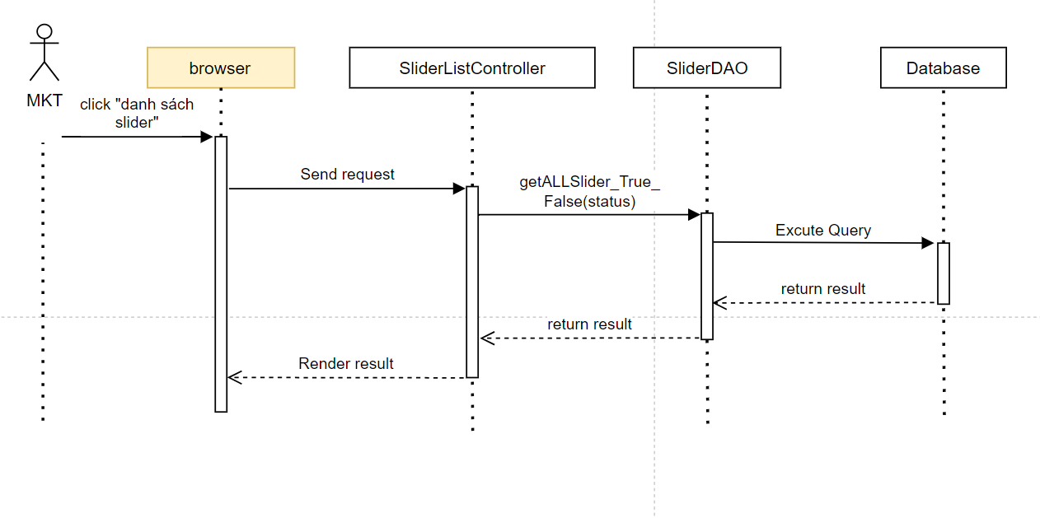
SEQUENCE DIAGRAM
(MKT SLIDERS LIST)

Slide 20
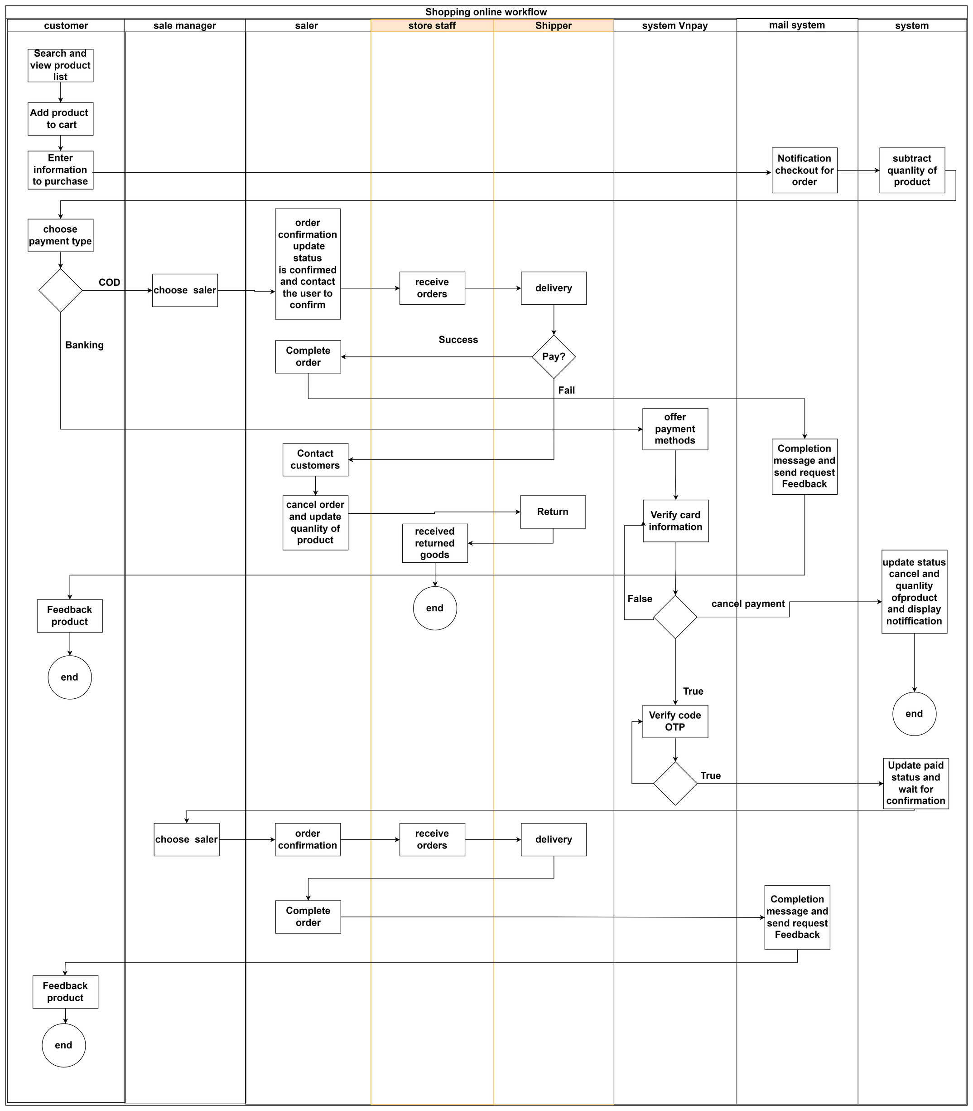
SHOPPING ONLINE
WORKFLOWS

Slide 21


Slide 22


THANK YOU

